Slide 1

计算机组成与系统结构 Computer Organization & System Architecture
Huang Kejie (黄科杰) 百人计划研究员
Office: 玉泉校区老生仪楼304
Email address: huangkejie@zju.edu.cn
HP: 17706443800

Slide 2
Handling Stores with Write-Through
Store instructions write to memory, changing values
Need to make sure cache and memory have same values on writes: two policies
1) Write-Through Policy: write cache and write through the cache to memory
Every write eventually gets to memory
Too slow, so include Write Buffer to allow processor to continue once data in Buffer
Buffer updates memory in parallel to processor

Slide 3
Write-Through Cache
Write both values in cache and in memory
Write buffer stops CPU from stalling if memory cannot keep up
Write buffer may have multiple entries to absorb bursts of writes
What if store misses in cache?
Processor
32-bit
Address
32-bit
Data
Cache
252
12
1022
Write Buffer
99
131
7
2041
20
Addr
Data
32-bit
Address
32-bit
Data
Memory

Slide 4
Handling Stores with Write-Back
2) Write-Back Policy: write only to cache and then write cache block back to memory when evict block from cache
Writes collected in cache, only single write to memory per block
Include bit to see if wrote to block or not, and then only write back if bit is set
Called “Dirty” bit (writing makes it “dirty”)

Slide 5
Write-Back Cache
Store/cache hit, write data in cache only and set dirty bit
Memory has stale value
Store/cache miss, read data from memory, then update and set dirty bit
“Write-allocate” policy
Load/cache hit, use value from cache
On any miss, write back evicted block, only if dirty. Update cache with new block and clear dirty bit
Processor
32-bit
Address
32-bit
Data
Cache
252
D
12
1022
Dirty Bits
D
99
131
D
7
2041
D
20
32-bit
Address
32-bit
Data
Memory

Slide 6
Write-Through vs. Write-Back
Write-Through:
Simpler control logic
More predictable timing simplifies processor control logic
Easier to make reliable, since memory always has copy of data (big idea: Redundancy!)
Write-Back
More complex control logic
More variable timing (0,1,2 memory accesses per cache access)
Usually reduces write traffic
Harder to make reliable, sometimes cache has only copy of data

Slide 7
Write Policy Choices
Cache Hit:
Write through: writes both cache & memory on every access
Generally higher memory traffic but simpler pipeline & cache design
Write back: writes cache only, memory written only when dirty entry evicted
A dirty bit per line reduces write-back traffic
Must handle 0, 1, or 2 accesses to memory for each load/store
Cache Miss:
No write allocate: only write to main memory
Write allocate (aka fetch on write): fetch into cache
Common combinations:
Write through and no write allocate
Write back with write allocate

Slide 8
Write Performance
Tag
Index
Offset
b
t
k
V
Tag
Data
2^{k}
lines
t
=
WE
HIT
Data Word or Byte

Slide 9
Reducing Write Hit Time
Problem: Writes take two cycles in memory stage, one cycle for tag check plus one cycle for data write if hit
Solutions:
Design data RAM that can perform read and write in one cycle, restore old value after tag miss
Fully-associative (CAM Tag) caches: Word line only enabled if hit
Pipelined writes: Hold write data for store in single buffer ahead of cache, write cache data during next store’s tag check

Slide 10
Pipelining Cache Writes
Address and Store Data From CPU
Tag
Index
Store Data
Delayed Write Addr.
Delayed Write Data
Load/Store
=?
Tags
S
Data
L
=?
1
0
Load Data to CPU
Hit?
Data from a store hit is written into data portion of cache during tag access of subsequent store

Slide 11
Write Buffer to Reduce Read Miss Penalty
Unified L2 Cache
Data Cache
CPU
RF
Write
buffer
Evicted dirty lines for writeback cache
OR
All writes in writethrough cache
Processor is not stalled on writes, and read misses can go ahead of write to main memory
Problem: Write buffer may hold updated value of location needed by a read miss
Simple solution: on a read miss, wait for the write buffer to go empty
Faster solution: Check write buffer addresses against read miss addresses, if no match, allow read miss to go ahead of writes, else, return value in write buffer

Slide 12
Reducing Tag Overhead with Sub-Blocks
Problem: Tags are too large, i.e., too much overhead
Simple solution: Larger lines, but miss penalty could be large.
Solution: Sub-block placement (aka sector cache)
A valid bit added to units smaller than full line, called sub-blocks
Only read a sub-block on a miss
If a tag matches, is the word in the cache?
100
300
204
1 1 1 1
1 0 0
0 1 0 1

Slide 13
Reducing Tag Overhead with Sub-Blocks
Problem: A memory cannot be large and fast
Solution: Increasing sizes of cache at each level
DRAM
CPU
L2$
L1$
Local miss rate = misses in cache / accesses to cache
Global miss rate = misses in cache / CPU memory accesses
Misses per instruction = misses in cache / number of instructions

Slide 14
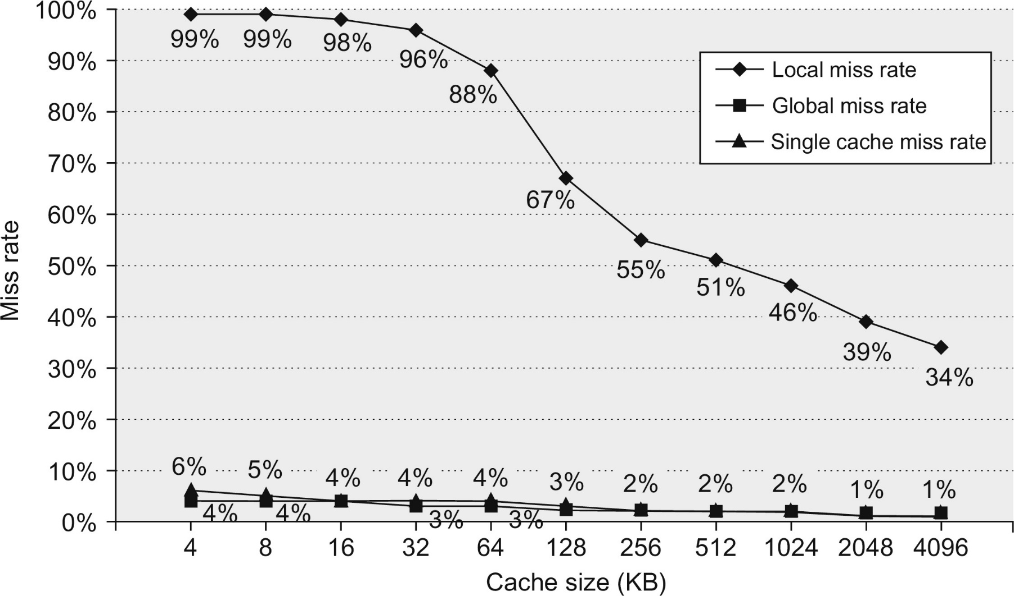
Figure B.14 Miss rates versus cache size for multilevel caches. Second-level caches smaller than the sum of the two 64 KiB first-level caches make little sense, as reflected in the high miss rates. After 256 KiB the single cache is within 10% of the global miss rates. The miss rate of a single-level cache versus size is plotted against the local miss rate and global miss rate of a second-level cache using a 32 KiB first-level cache. The L2 caches (unified) were two-way set associative with replacement. Each had split L1 instruction and data caches that were 64 KiB two-way set associative with LRU replacement. The block size for both L1 and L2 caches was 64 bytes. Data were collected as in Figure B.4.

Slide 15
Presence of L2 influences L1 design
Use smaller L1 if there is also L2
Trade increased L1 miss rate for reduced L1 hit time
Backup L2 reduces L1 miss penalty
Reduces average access energy
Use simpler write-through L1 with on-chip L2
Write-back L2 cache absorbs write traffic, doesn’t go off-chip
At most one L1 miss request per L1 access (no dirty victim write back) simplifies pipeline control
Simplifies coherence issues
Simplifies error recovery in L1 (can use just parity bits in L1 and reload from L2 when parity error detected on L1 read)

Slide 16
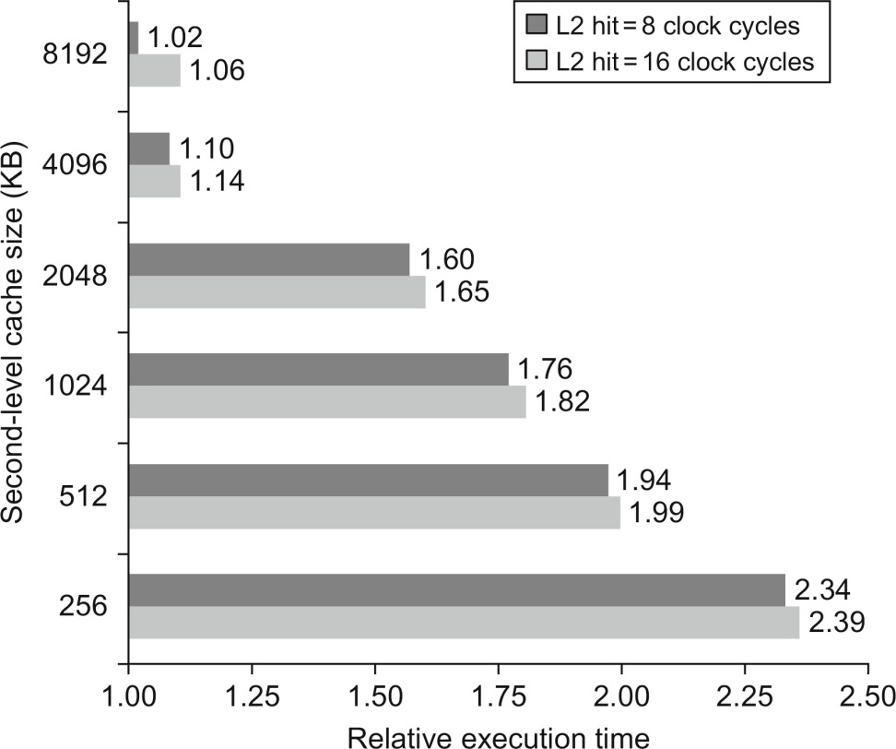
Figure B.15 Relative execution time by second-level cache size. The two bars are for different clock cycles for an L2 cache hit. The reference execution time of 1.00 is for an 8192 KiB second-level cache with a 1-clock-cycle latency on a second-level hit. These data were collected the same way as in Figure B.14, using a simulator to imitate the Alpha 21264.

Slide 17
Inclusion Policy
Inclusive multilevel cache:
Inner cache can only hold lines also present in outer cache
External coherence snoop access need only check outer cache
Exclusive multilevel caches:
Inner cache may hold lines not in outer cache
Swap lines between inner/outer caches on miss
Used in AMD Athlon with 64KB primary and 256KB secondary cache
Why choose one type or the other?

Slide 18
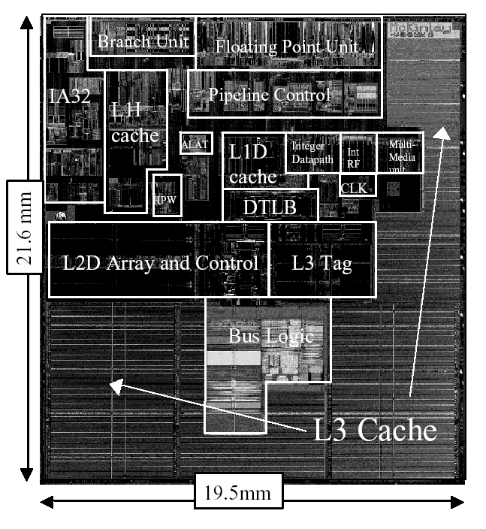
Itanium-2 On-Chip Caches (Intel/HP, 2002)
Level 1: 16KB, 4-way s.a., 64B line, quad-port (2 load+2 store), single cycle latency
Level 2: 256KB, 4-way s.a, 128B line, quad-port (4 load or 4 store), five cycle latency
Level 3: 3MB, 12-way s.a., 128B line, single 32B port, twelve cycle latency

Slide 19
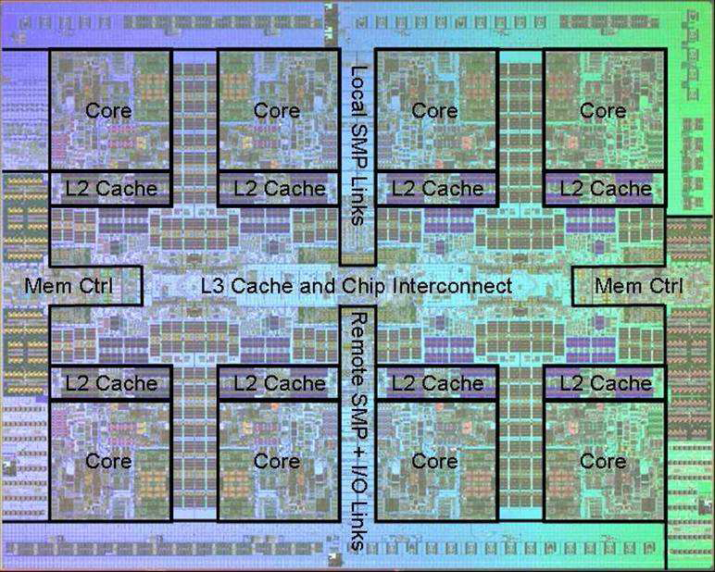
Power 7 On-Chip Caches [IBM 2009]
32KB L1 I$/core
32KB L1 D$/core
3-cycle latency
256KB Unified L2$/core
8-cycle latency
32MB Unified Shared L3$
Embedded DRAM (eDRAM)
25-cycle latency to local slice

Slide 20
IBM z196 Mainframe Caches 2010
96 cores (4 cores/chip, 24 chips/system)
Out-of-order, 3-way superscalar @ 5.2GHz
L1: 64KB I-$/core + 128KB D-$/core
L2: 1.5MB private/core (144MB total)
L3: 24MB shared/chip (eDRAM) (576MB total)
L4: 768MB shared/system (eDRAM)

Slide 21
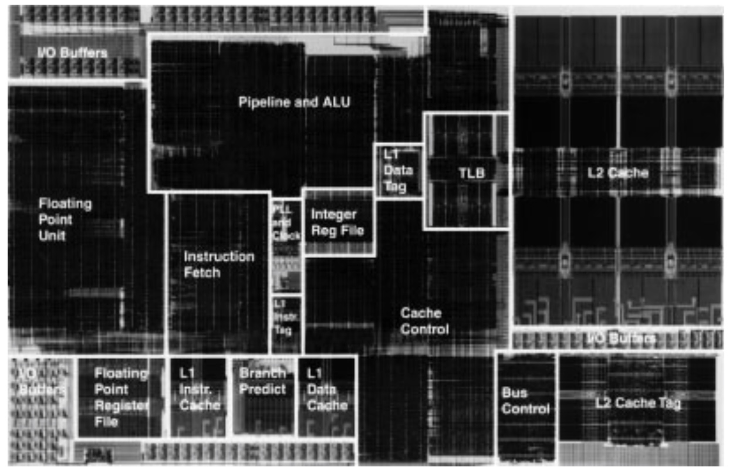
Exponential X704 PowerPC Processor(1997)
32KB L2 8-way Set-Associative Write-Back Unified Cache
0.5µm BiCMOS
Ran at 410-533MHz when other PC processors were much lower clock rate
Project delayed –missed market window for Apple
2KB L1 Direct-Mapped Instruction Cache
2KB L1 Direct-Mapped Write-Through Data Cache

Slide 22
Victim Caches (HP 7200)
CPU
Unified L2 Cache
L1 Data Cache
RF
Evicted data
from L1
Victim
FA Cache
4 blocks
to where?
Hit data from VC (miss in L1)
Evicted data
from VC
Victim cache is a small associative backup cache, added to a direct-mapped cache, which holds recently evicted lines
First look up in direct-mapped cache
If miss, look in victim cache
If hit in victim cache, swap hit line with line now evicted from L1
If miss in victim cache, L1 victim -> VC, VC victim->?
Fast hit time of direct mapped but with reduced conflict misses

Slide 23
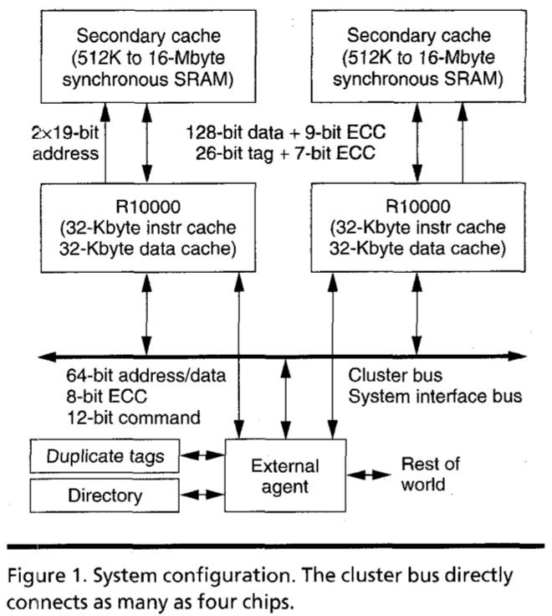
MIPS R10000 Off-Chip L2 Cache (Yeager, IEEE Micro 1996)

Slide 24
Way-Predicting Caches
(MIPS R10000 L2 cache)
Use processor address to index into way-prediction table
Look in predicted way at given index, then:
HIT
MISS
Return copy
of data from
cache
Look in other way
Read block of data from
next level of cache
MISS
SLOW HIT
(change entry in prediction table)

Slide 25
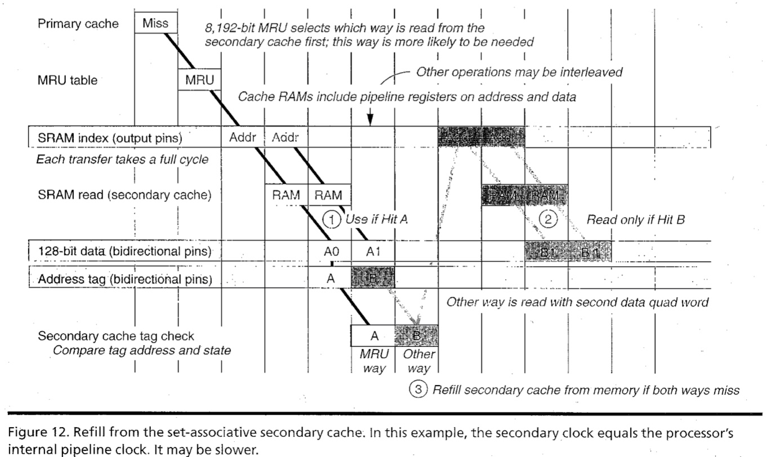
R10000 L2 Cache Timing Diagram

Slide 26
Way-Predicting Instruction Cache (Alpha 21264-like)
Jump target
Store last-used way for sequential path and predicted branch taken path. Can be fetching multiple instructions per cycle.
0x4
Jump control
Add
PC
addr
inst
Primary
Instruction
Cache
way
Sequential Way
Branch Target Way

Slide 27
Reduce Miss Penalty of Long Blocks: Early Restart and Critical Word First
Don’t wait for full block before restarting CPU
Early restart—As soon as the requested word of the block arrives, send it to the CPU and let the CPU continue execution
Critical Word First—Request the missed word first from memory and send it to the CPU as soon as it arrives; let the CPU continue execution while filling the rest of the words in the block
Long blocks more popular today ⇒ Critical Word 1st Widely used
To CPU
To CPU
Word 0
Word 2
Word 1
Word 3
Word 2
Word 0
Rest of line filled in with wrap-around on cache line
Word 3
Word 1

Slide 28
Increasing Cache Bandwidth with Non-Blocking Caches
Non-blocking cache or lockup-free cache allow data cache to continue to supply cache hits during a miss
requires Full/Empty bits on registers or out-of-order execution
“hit under miss” reduces the effective miss penalty by working during miss vs. ignoring CPU requests
“hit under multiple miss” or “miss under miss” may further lower the effective miss penalty by overlapping multiple misses
Significantly increases the complexity of the cache controller as there can be multiple outstanding memory accesses, and can get miss to line with outstanding miss (secondary miss)
Requires pipelined or banked memory system (otherwise cannot support multiple misses)
Pentium Pro allows 4 outstanding memory misses
Cray X1E vector supercomputer allows 2,048 outstanding memory misses

Slide 29
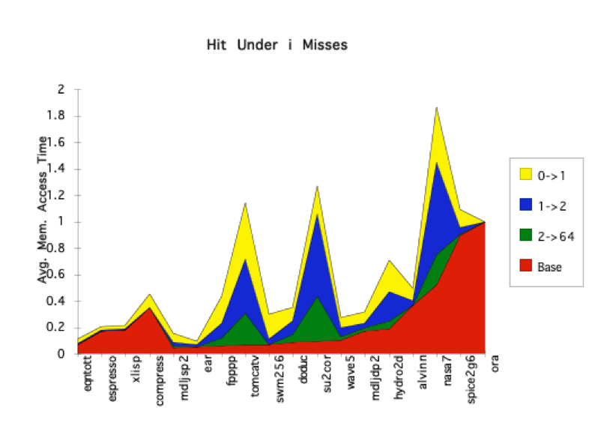
Value of Hit Under Miss for SPEC (old data)
“Hit under n Misses”
Floating Point
0->1
1->2
2->64
Base
Integer
FP programs on average: AMAT= 0.68 -> 0.52 -> 0.34 -> 0.26
Int programs on average: AMAT= 0.24 -> 0.20 -> 0.19 -> 0.19
8 KB Data Cache, Direct Mapped, 32B block, 16 cycle miss, SPEC 92

Slide 30
Prefetching
Speculate on future instruction and data accesses and fetch them into cache(s)
Instruction accesses easier to predict than data accesses
Varieties of prefetching
Hardware prefetching
Software prefetching
Mixed schemes
What types of misses does prefetching affect?

Slide 31
Issues in Prefetching
Usefulness – should produce hits
Timeliness – not late and not too early
Cache and bandwidth pollution
L1 Instruction
Unified L2 Cache
CPU
L1 Data
RF
Prefetched data

Slide 32
Hardware Instruction Prefetching
Instruction prefetch in Alpha AXP 21064
Fetch two lines on a miss; the requested line (i) and the next consecutive line (i+1)
Requested line placed in cache, and next line in instruction stream buffer
If miss in cache but hit in stream buffer, move stream buffer line into cache and prefetch next line (i+2)
Prefetched
instruction line
Req
line
Stream
Buffer
CPU
Unified L2 Cache
L1 Instruction
RF
Req
line

Slide 33
Hardware Data Prefetching
Prefetch-on-miss:
Prefetch b + 1 upon miss on b
One-Block Lookahead (OBL) scheme
Initiate prefetch for block b + 1 when block b is accessed
Why is this different from doubling block size?
Can extend to N-block lookahead
Strided prefetch
If observe sequence of accesses to line b, b+N, b+2N, then prefetch b+3N etc.
Example: IBM Power 5 [2003] supports eight independent streams of strided prefetch per processor, prefetching 12 lines ahead of current access

Slide 34
Software Prefetching
for(i=0; i < N; i++) { prefetch( &a[i + 1] ); prefetch( &b[i + 1] ); SUM = SUM + a[i] * b[i]; }

Slide 35
Software Prefetching Issues
Timing is the biggest issue, not predictability
If you prefetch very close to when the data is required, you might be too late
Prefetch too early, cause pollution
Estimate how long it will take for the data to come into L1, so we can set P appropriately
Why is this hard to do?
for(i=0; i < N; i++) { prefetch( &a[i + P] ); prefetch( &b[i + P] ); SUM = SUM + a[i] * b[i]; }
Must consider cost of prefetch instructions

Slide 36
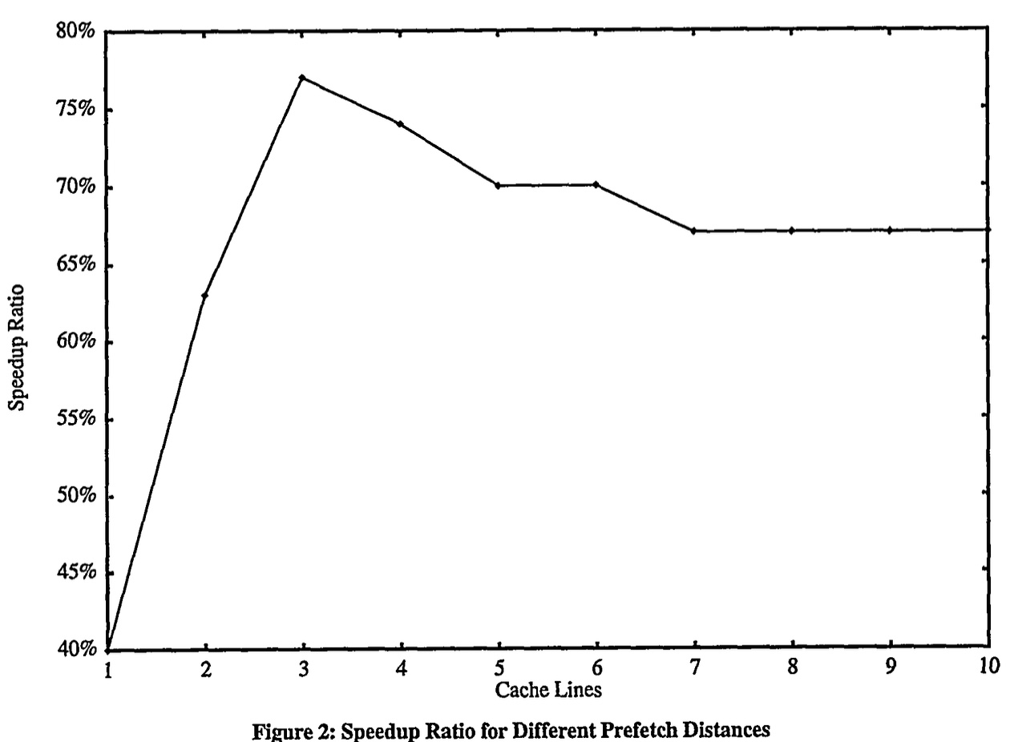
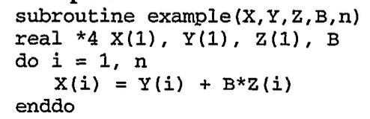
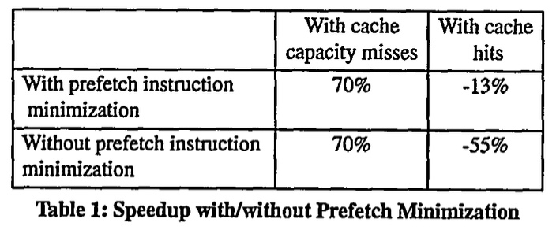
Software Prefetching Example
[“Data prefetching on the HP PA8000”, Santhanam et al., 1997]

Slide 37
Compiler Optimizations
Restructuring code affects the data access sequence
Group data accesses together to improve spatial locality
Re-order data accesses to improve temporal locality
Prevent data from entering the cache
Useful for variables that will only be accessed once before being replaced
Needs mechanism for software to tell hardware not to cache data (“no-allocate” instruction hints or page table bits)
Kill data that will never be used again
Streaming data exploits spatial locality but not temporal locality
Replace into dead cache locations

Slide 38
Loop Interchange
for(j=0; j < N; j++) { for(i=0; i < M; i++) { x[i][j] = 2 * x[i][j]; } }
for(i=0; i < M; i++) { for(j=0; j < N; j++) { x[i][j] = 2 * x[i][j]; } }
What type of locality does this improve?

Slide 39
Loop Fusion
for(i=0; i < N; i++) a[i] = b[i] * c[i];
for(i=0; i < N; i++)
d[i] = a[i] * c[i];
for(i=0; i < N; i++) { a[i] = b[i] * c[i]; d[i] = a[i] * c[i];
}
What type of locality does this improve?

Slide 40
Matrix Multiply, Naïve Code
z
j
for(i=0; i < N; i++) for(j=0; j < N; j++) { r = 0; for(k=0; k < N; k++) r = r + y[i][k] * z[k][j]; x[i][j] = r; }
k
y
k
x
j
i
i
Not touched
Old access
New access

Slide 41
Matrix Multiply with Cache Tiling
z
j
for(jj=0; jj < N; jj=jj+B) for(kk=0; kk < N; kk=kk+B) for(i=0; i < N; i++) for(j=jj; j < min(jj+B,N); j++) { r = 0; for(k=kk; k < min(kk+B,N); k++) r = r + y[i][k] * z[k][j]; x[i][j] = x[i][j] + r; }
k
y
k
x
j
i
i
What type of locality does this improve?

